Slide 1

EC2, S3, IAM, CloudWatch
Sequoia AWS Boot Camp 2014

Slide 2
Agenda: AWS Advanced Topics
AWS Services in Detail.
Intro.
EC2.
Auto Scale.
S3.
IAM.
CloudWatch.

Slide 3
Approach
Use process of migrating a simple RoR application into AWS cloud as a driver to highlight various AWS components.
Enhance application to take advantage of AWS autoscale and high availability features.

Slide 4
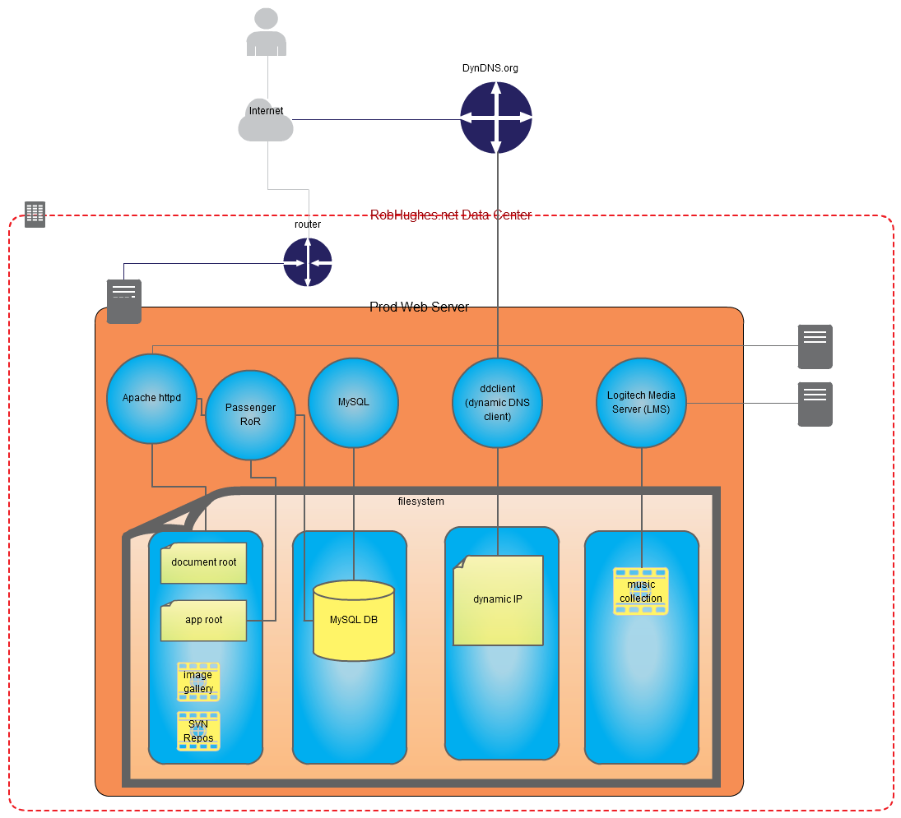
RobHughes.net (RHDN) current

Slide 5
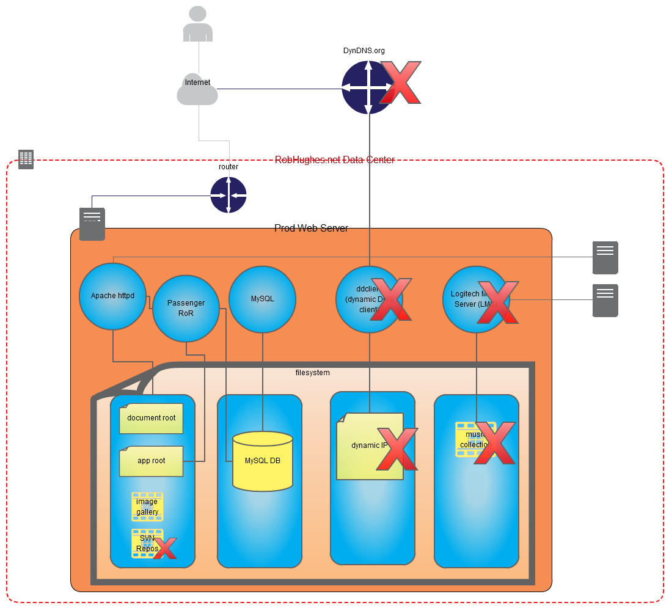
RobHughes.net (RHDN) migrate to AWS

Slide 6




RHDN Requirements
Software
Apache httpd/Phusion Passenger in front of Ruby 2.x/Rails 4.1.
MySQL RDBMS.
Linux OS. Red Hat variant preferred.
Security
Restrict access to HTTP/ssh (80, 22) for web-tier.
Restrict access to MySQL port and ssh (3306, 22) for data-tier.
Restrict who can log into web/data-tier servers.
Amazon RDS
AMI
Amazon VPC
security group
IAM

Slide 7





RHDN Requirements
AWS
Autoscaled server instances. Cluster grows/shrinks to meet demands.
Highly available infrastructure.
Load balancer for web-tier.
DNS entry for www.robhughes.net.
Stage static content (images).
Ability to create duplicate environments for dev/test.
Auto Scaling
Amazon EC2
Availability Zone
region
Elastic Load
Balancing
Amazon Route 53
Amazon S3
AWS CloudFormation

Slide 8
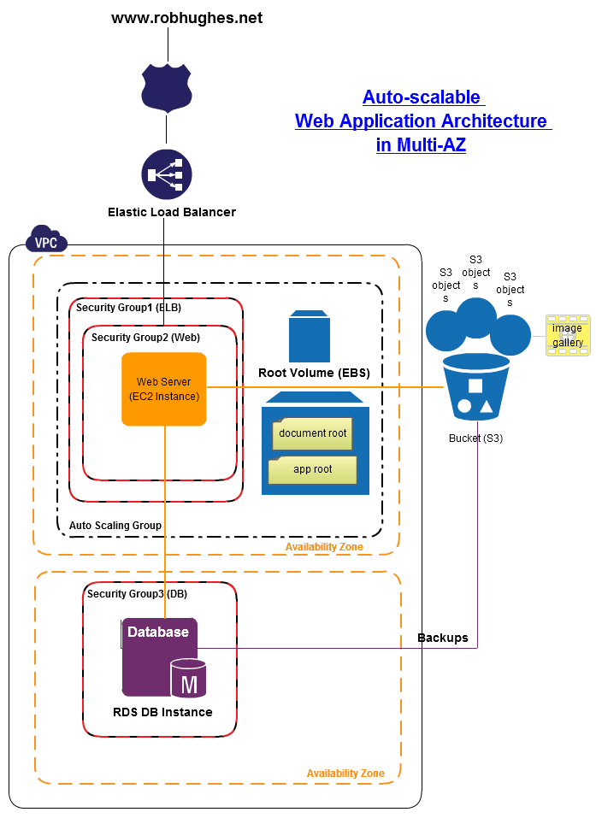
RobHughes.net (RHDN)proposed

Slide 9
Map requirements to AWS offerings
Compute & Network
Deployment & Management
Storage & Content Delivery
Database

Slide 10
Map requirements to AWS core offerings
Compute & Network
Deployment & Management
Auto Scaling
Amazon EC2
Amazon RDS
Availability Zone
region
AMI
Elastic Load
Balancing
Storage & Content Delivery
Database
Amazon VPC
Amazon Route 53
Amazon S3
security group
AWS CloudFormation
IAM

Slide 11
Map requirements to aws core offerings
Compute & Network
Deployment & Management
Auto Scaling
Amazon EC2
Amazon RDS
Availability Zone
region
AMI
Elastic Load
Balancing
Storage & Content Delivery
Database
Amazon VPC
Amazon Route 53
Amazon S3
security group
AWS CloudFormation
IAM

Slide 12
Map requirements to AWS core offerings
Compute & Network
EC2
Auto Scaling
Elastic Load Balancer (ELB)
Direct Connect
Route 53
VPC
Deployment & Management
CloudFormation
CloudTrail
CloudWatch
Elastic Beanstalk
IAM
OpsWorks
Trusted Advisor
Storage & Content Delivery
Elastic Block Store (EBS)
Glacier
S3
Storage Gateway
CloudFront
Database
DynamoDB
ElastiCache
RDS
Redshift

Slide 13
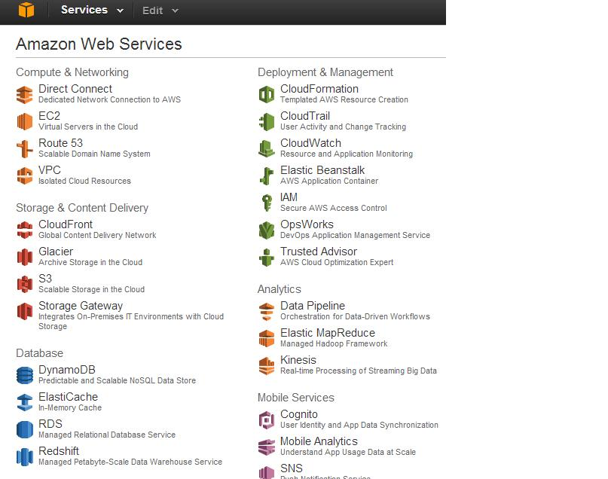
AWS Management Console

Slide 14
Agenda: AWS Advanced Topics
AWS Services in Detail.
Intro.
EC2.
Auto Scale.
S3.
IAM.
CloudWatch.

Slide 15
Elastic Compute Cloud(EC2)
EC2 is the jumping off point for managing computational resources.
Computational resources include:
servers (known as instances).
services like Elastic Map Reduce (EMR).
Creating computational resources requires lots of other things:
Storage, security, access controls, networking, monitoring, etc.
EC2 is elastic in the sense that computational resources are resizable.

Slide 16
EC2 Resizable
EC2 is resizable in a number of ways:
Vertical: Change instance type to change CPU capacity (number and speed of CPUs) and memory capacity assigned to an instance.
Horizontal: EC2 instances are scalable (more on the later).

Slide 17
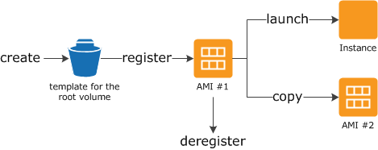
EC2 – AMIs vs Instances
Amazon Machine Image (AMI)
From http://docs.aws.amazon.com/AWSEC2/latest/UserGuide/AMIs.html
An Amazon Machine Image (AMI) provides the information required to launch an instance, which is a virtual server in the cloud. You specify an AMI when you launch an instance, and you can launch as many instances from the AMI as you need.
An AMI includes the following:
A template for the root volume for the instance (for example, an operating system, an application server, and applications)
Launch permissions that control which AWS accounts can use the AMI to launch instances
A block device mapping that specifies the volumes to attach to the instance when it's launched

Slide 18
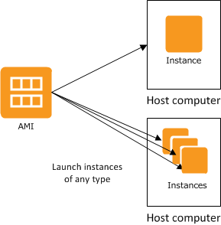
EC2 – AMIs vs Instances
Instances
From http://docs.aws.amazon.com/AWSEC2/latest/UserGuide/ec2-instances-and-amis.html
From an AMI, you launch an instance, which is a copy of the AMI running as a virtual server in the cloud. You can launch multiple instances of an AMI, as shown in the following figure.
Your instances keep running until you stop or terminate them, or until they fail. If an instance fails, you can launch a new one from the AMI.

Slide 19
EC2 Features
Reduced time to market. Can create new instances within minutes.
Fast*boot time plays well with ability to quickly scale to meet demand.
Pay as you go.
Many Amazon Machine Images (AMIs) available to choose from.
Some require you to install/configure software.
Many others with pre-installed software stacks.
* Fast depends on a number of factors.

Slide 20
Agenda: AWS Advanced Topics
AWS Services in Detail.
Intro.
EC2.
Auto Scale.
S3.
IAM.
CloudWatch.

Slide 21
Auto Scale
Scale number of instances to meet demands.
Discuss historical static provisioning of servers.
Use cases:
Over provisioning resources, under provisioning, unexpected demand.
Customer specifies the rules used to scale server instances up and down.
Scale up during known peak usage periods and down during known lull times.
Scale instances dynamically based on traffic/CPU load.
Complemented by CloudWatch monitoring service.
Complemented by Elastic Load Balancing service.
Customer can specify minimum/maximum number of servers.
Other features including use of “spot” instances.

Slide 22
Scalable Web Applications
Traditional Web Hosting
Use forecast models to provision ahead of demand
Static provisioning of hosts
AWS Web Hosting
Instances can be provisioned on-the-fly based on triggers
Capacity groups grow/shrink as needed
AWS web application benefit by being stateless which allows instances to be created when needed
--OR--

Slide 23
Using EC2
Select a pre-configured AMI (possibly one that you have previously created containing your software, libraries, data, and configuration settings).
Select security settings, network access, allowed users (IAM), public keys for SSH access.
Select instance type (CPU capacity, memory capacity, storage) and which availability zones to use and launch instances.
Use instances. Monitor instances. Stop/terminate instances.
Attach storage (EBS volumes) if desired.
Pay for what you use.

Slide 24
EC2 Use
Interact with EC2 via:
AWS Management Console.
“aws” command line interface (CLI).
AWS EC2 CLI.
AWS EC2 Web Service Query API.
Interact via HTTP.

Slide 25
EC2 Dashboard – Instance Creation
Internet connection?
Yes
Instance creation live demo
No
Static screen snaps

Slide 26
AWS Management Console

Slide 27
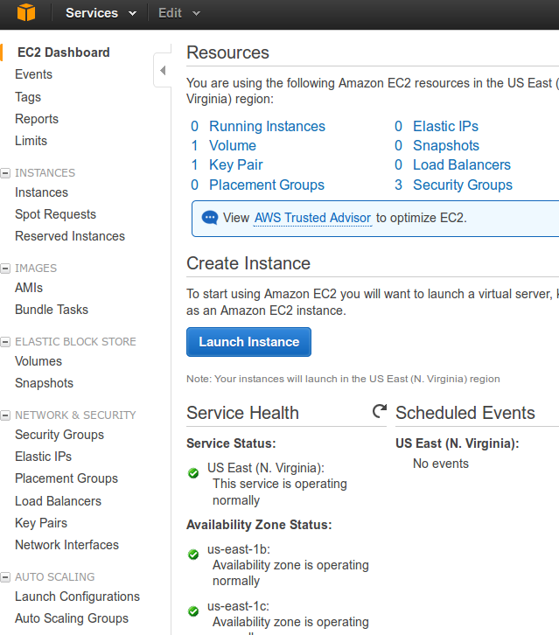
EC2 Dashboard Launch Wizard

Slide 28
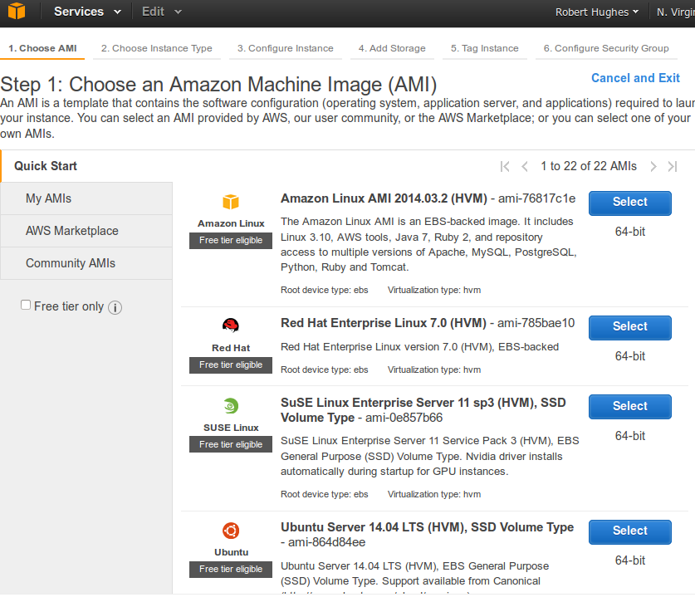
EC2 Select AMI - Step 1

Slide 29
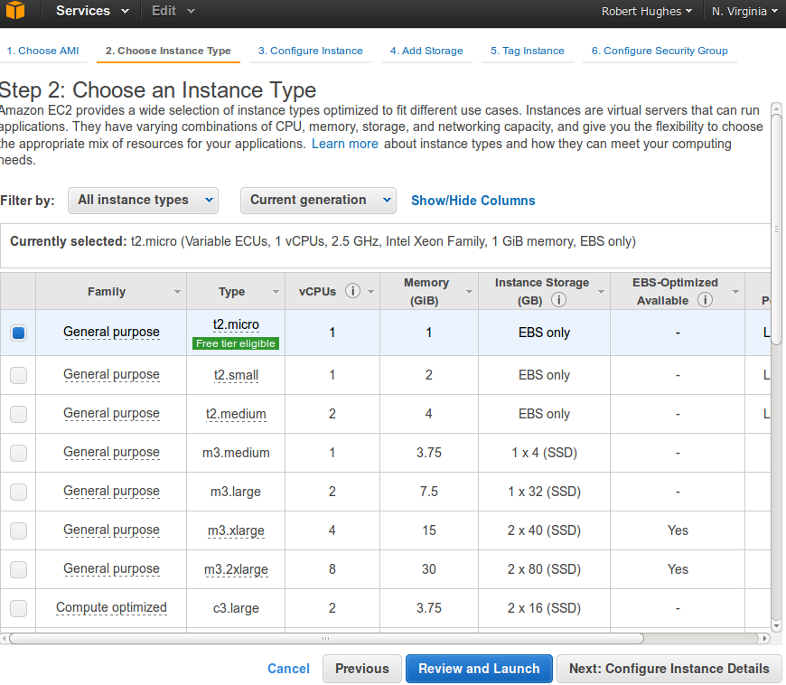
EC2 Choose Instance Type - Step 2

Slide 30
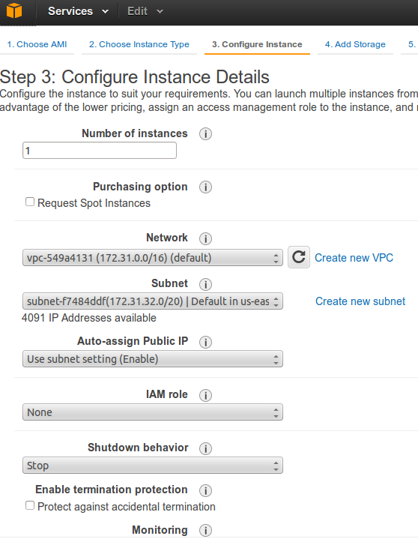
EC2 Configure Details - Step 3

Slide 31
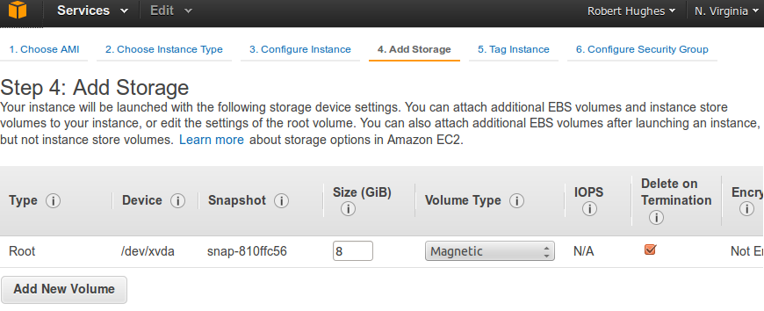
EC2 Add Storage - Step 4

Slide 32
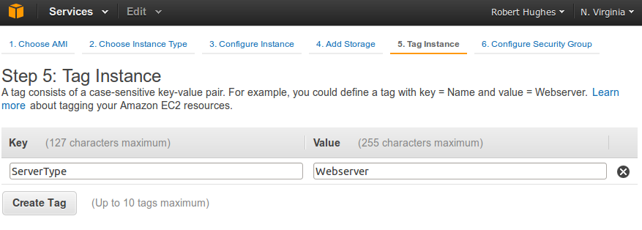
EC2 Add Tags - Step 5

Slide 33
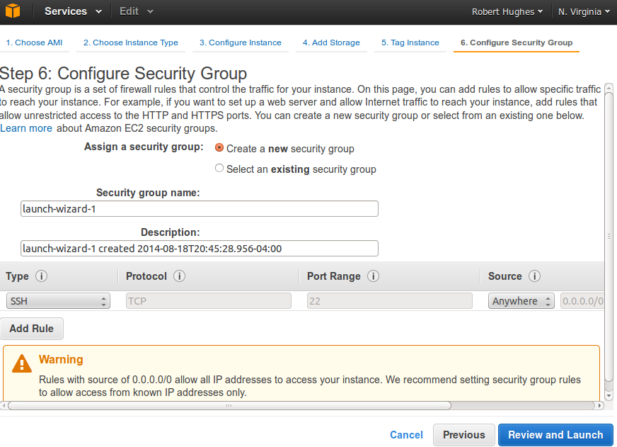
EC2 Security Groups - Step 6

Slide 34
Sample ‘aws’ CLI command to interact with EC2
$ aws ec2 describe-instances --instance-ids i-4106226a
{
"Reservations": [
{
"OwnerId": "524683554318",
"ReservationId": "r-f01c3f8f",
"Groups": [],
"Instances": [
{
"Monitoring": {
"State": "disabled"
},
"PublicDnsName": null,
"KernelId": "aki-919dcaf8",
"State": {
"Code": 80,
"Name": "stopped"
},
"EbsOptimized": false,
"LaunchTime": "2014-08-19T00:50:36.000Z",
"PrivateIpAddress": "172.31.17.66",
"ProductCodes": [],
"VpcId": "vpc-549a4131",
"StateTransitionReason": "User initiated (2014-08-19 02:13:25 GMT)",
"InstanceId": "i-4106226a",
"ImageId": "ami-7c807d14",
"PrivateDnsName": "ip-172-31-17-66.ec2.internal",
"KeyName": "RobertHughes",
"SecurityGroups": [
{
"GroupName": "rhdn_web_tier",
"GroupId": "sg-7dc3b018"
}
],
"ClientToken": "mSrFA1405290927010",
"SubnetId": "subnet-f802fa8f",
"InstanceType": "t1.micro",
<snip>
]
}
]
}
Default ‘aws’ output is json

Slide 35
Sample ‘aws’ CLI command to interact with EC2
$ aws ec2 start-instances --instance-ids i-4106226a
{
"StartingInstances": [
{
"InstanceId": "i-4106226a",
"CurrentState": {
"Code": 0,
"Name": "pending"
},
"PreviousState": {
"Code": 80,
"Name": "stopped"
}
}
]
}
$ aws ec2 stop-instances --instance-ids i-4106226a
{
"StoppingInstances": [
{
"InstanceId": "i-4106226a",
"CurrentState": {
"Code": 64,
"Name": "stopping"
},
"PreviousState": {
"Code": 16,
"Name": "running"
}
}
]
}

Slide 36
RHDN Requirements
With EC2 we can now:
Create Linux instances.
Install Apache, Passenger, Ruby/RubyGems packages from AWS repo.
Install ruby gems from RubyGems.org.
Install MySQL.
Create Security Groups to configure firewall rules.
Create Load Balancer.

Slide 37
Agenda: AWS Advanced Topics
AWS Services in Detail.
Intro.
EC2.
Auto Scale.
S3.
IAM.
CloudWatch.

Slide 38
Simple Storage Service (S3)
Amazon Simple Storage Service (Amazon S3) is storage for the Internet. You can use Amazon S3 to store and retrieve any amount of data at any time, from anywhere on the web.
Amazon S3 stores data as objects within buckets. An object consists of a file and optionally any metadata that describes that file.
To store an object in Amazon S3, you upload the file you want to store to a bucket. When you upload a file, you can set permissions on the object as well as any metadata.
Buckets are the containers for objects. You can have one or more buckets. For each bucket, you can control access to it (who can create, delete, and list objects in the bucket), view access logs for it and its objects, and choose the geographical region where Amazon S3 will store the bucket and its contents.
When using the AWS Management Console, you can create folders to group objects, and you can nest folders (create folders within folders).

Slide 39
S3 Features
High volume storage accessible over internet via HTTP.
High durability (99.999999999%).
Via redundant storage across AWS infrastructure.
High availability (99.99%).
Via redundant storage across AWS infrastructure.
Read, write, and delete objects from 1 byte to 5TBs of data.
The number of objects you can store is unlimited.
Each object is stored in a bucket and retrievable by a unique key.
Customer specifies data retention policies.
Customer may enable data versioning of objects.

Slide 40
S3 Access Controls
Amazon S3 has two ways of controlling access to buckets and objects:
Access Control Lists (ACLs)-Define permissions associated with individual buckets or objects.
Bucket Policies-A collection of statements that defines a user’s permissions to access S3 resources.
Policies can be attached to users, groups, or buckets.

Slide 41
S3 Use
Interact with S3 via:
AWS Management Console.
View usage and access logs.
View charges associated with use of bucket.
Create folders and upload files.
“aws” command line interface (CLI).
Copy files to/from S3.
Custom APIs.
Standard command line utilities like wget and curl
Use HTTP semantics to GET files.

Slide 42
S3 URLs
The ‘aws’ command line interface (CLI) uses the “s3://” scheme.
Some services (like CloudFormation) use http:// and https:// schemes.
When using http and https schemes the following alternate methods of specifying the target bucket and S3 namespace are generally acceptable:
https://s3.amazonaws.com/robhughesdotnet/example/myconfig
https://robhughesdotnet.s3.amazonaws.com/example/myconfig

Slide 43
Anatomy of an S3 URL
https://s3.amazonaws.com/robhughesdotnet/example/myconfig
Scheme
S3 Namespace
Bucket
Prefix (intermediate objects)
Object
https://
s3.amazon.com
robhughesdotnet
example
myconfig

Slide 44
Anatomy of an S3 URL
s3://robhughesdotnet/example/myconfig
Scheme
S3 Namespace
Bucket
Prefix (intermediate objects)
Object
s3://
s3.amazon.com (implied by s3:// scheme)
robhughesdotnet
example
myconfig

Slide 45
S3 Dashboard – Interacting with S3 bucket
Internet connection?
Yes
Instance creation live demo
No
Static screen snaps

Slide 46
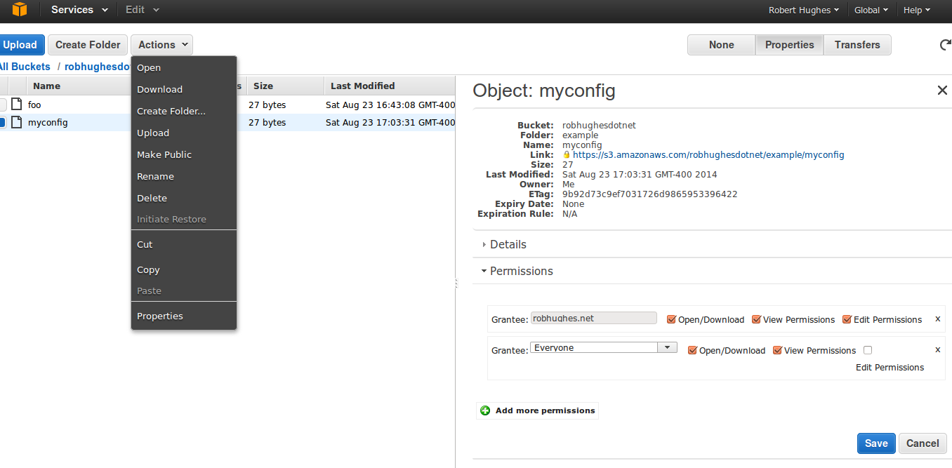
S3 Dashboard With Context Menu

Slide 47
S3 – CLI Interaction
List bucket/folder contents using ‘aws’ CLI with s3 subcommand:
$ aws s3 ls s3://robhughesdotnet/example/
2014-08-23 16:42:38 0
2014-08-23 17:07:59 27 foo
2014-08-23 17:03:31 27 myconfig
Retrieve an object (file) from S3 using common Linux command line utility:
$ wget https://s3.amazonaws.com/robhughesdotnet/example/myconfig
--2014-08-23 17:04:40-- https://s3.amazonaws.com/robhughesdotnet/example/myconfig
Resolving s3.amazonaws.com (s3.amazonaws.com)... 54.231.16.128
Connecting to s3.amazonaws.com (s3.amazonaws.com)|54.231.16.128|:443... connected.
HTTP request sent, awaiting response... 200 OK
Length: 27 [binary/octet-stream]
Saving to: `myconfig'
100%[=============================================>] 27 --.-K/s in 0.002s
2014-08-23 17:04:40 (13.8 KB/s) - `myconfig' saved [27/27]

Slide 48
S3 – CLI Interaction
Use ‘aw’ CLI to delete, upload and list S3 bucket/folder
$ aws s3 rm s3://robhughesdotnet/example/foo
delete: s3://robhughesdotnet/example/foo
2014-08-23 16:42:38 0
2014-08-23 17:03:31 27 myconfig
$ aws s3 cp foo s3://robhughesdotnet/example/
upload: ./foo to s3://robhughesdotnet/example/foo
$ aws s3 ls s3://robhughesdotnet/example/
2014-08-23 16:42:38 0
2014-08-23 17:07:59 27 foo
2014-08-23 17:03:31 27 myconfig
Alternate acceptable URL syntax to specify bucket and S3 namespace:
wget https://s3.amazonaws.com/robhughesdotnet/example/myconfig
wget https://robhughesdotnet.s3.amazonaws.com/example/myconfig

Slide 49
S3 – CLI Interaction
Sync a local directory to an S3 bucket:
$ aws s3 sync --exclude "*.svn" --exclude "*.svn/*" media s3://robhughesdotnet/example/media
upload: media/U2/Achtung Baby/11 Acrobat.mp3 to s3://robhughesdotnet/example/media/U2/Achtung Baby/11 Acrobat.mp3

Slide 50
S3 Typical Uses
Typical uses:
Content storage and distribution (e.g. CloudFront)
EC2 instances can push application/server logs to S3.
EMR pushes results of computation to S3 buckets.
Store static application data (e.g. images or media files).
CloudFormation templates must be stored in S3 buckets.
EC2 instance provisioning can pull application components from S3.
E.g. tar or zip files.
Store snapshots of EBS volumes.
Complemented by Glacier service to “age-off” older data that must be retained but infrequently accessed as part of a lifecycle management policy.

Slide 51
RHDN Requirements
With S3 we can now:
Create buckets.
To store static photo gallery content.
Create access control lists (ACLs).
Later for CloudFormation:
Store CloudFormation templates.
Store archive files containing application components use to provision auto scaled instances.

Slide 52
Agenda: AWS Advanced Topics
AWS Services in Detail.
Intro.
EC2.
Auto Scale.
S3.
IAM.
CloudWatch.

Slide 53
AWS Identity and Access Management (IAM)
AWS IAM service is used to centrally manage users, security credentials, and permissions that control which AWS resources a user (or identity) can access.
Manage roles and access.
Create roles and manage permissions to control which operations may be performed by the entities that assume the role.
Define which entities are allowed to assume the role.
Manage users and access.
Create users and assign security credentials to enable users access to resources and AWS services.
Manage permissions to decide what operations a user may perform.
Manage groups - Groups provide a convenient way to manage users as a unit.
Manage federated users and access.
Enable entity federation to allow existing entities to access resources such as AWS Management Console, to invoke AWS APIs, and other resources without creating individual IAM user for each identity.

Slide 54
IAM Users
Entities that you create in AWS enable people and processes to interact with AWS services.
IAM users do not just represent people. An IAM user can represent any entity that requires access to AWS and needs a password or credentials to do so.
Initially users have no permissions. You can add permissions to grant access to required AWS services and resources needed to perform a set of tasks.
If users require AWS Management Console access a password may be set.
Credentials may be created for use with aws CLI and SDK tools.
Each user is associated with one and only one AWS account. If an entity requires access to multiple AWS accounts then IAM roles may be used to permit cross account access.

Slide 55
IAM Users
When you create an AWS account a root user is created for the account.
You, and members of your team, may interact with AWS using the root account password and credentials but it is considered a best-practice to create additional users with limited permissions.

Slide 56
IAM Roles (Delegation and Federation)
AWS lists the following uses of IAM Roles:
Applications running on Amazon EC2 instances that need to access AWS resources.
Cross-account access.
Identity federation.
Web identity federation.

Slide 57
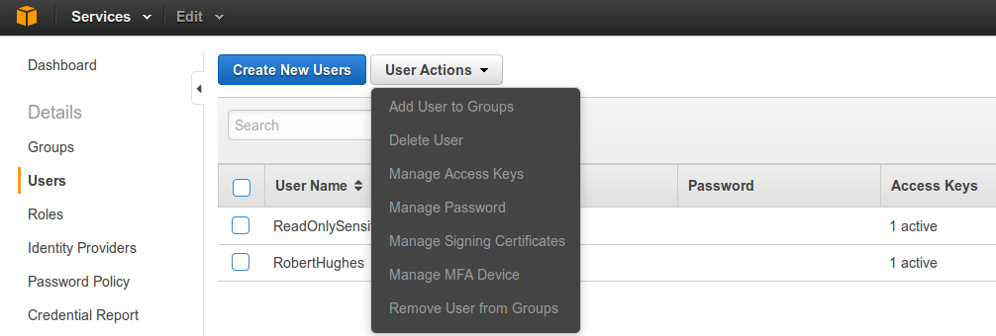
AWS Management Console IAM Dashboard

Slide 58
IAM Use
You can interact with IAM via:
AWS Management Console.
“aws” command line interface (CLI).
SDKs.
Standard command line utilities like wget and curl.
AWS IAM provides a web service for interacting with IAM via HTTP.
In general requests to the IAM web service must be signed. The aws CLI or SDKs sign the request on behalf of a user.

Slide 59
TODO Talk about policies???
User
Service
Resource Based
E.g. S3 Bucket policies

Slide 60
IAM/S3 User and Bucket Policy Interaction
Internet connection?
Yes
Create S3 Bucket and IAM User Policies
No
Static screen snaps

Slide 61
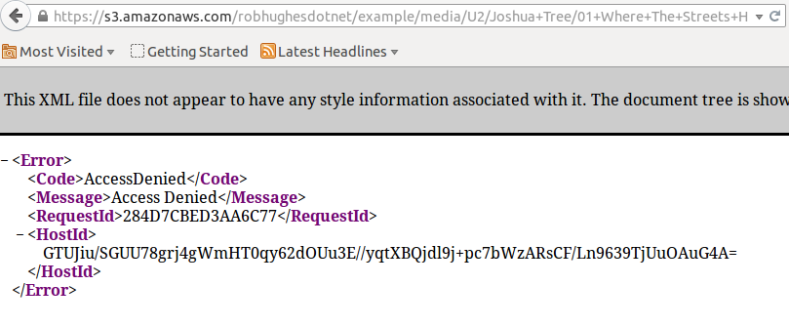
S3 Bucket Policy Denies Anonymous Access To example/*

Slide 62
S3 Bucket Policy
Resource based S3 bucket policy.
Grant complete control to root account (IAM users still need permissions to perform actions).
Grant read-only anonymous access to s3://robhughesdotnet/example/media/*.
{
"Version": "2012-10-17",
"Statement": [
{
"Sid": "UberRootAccess",
"Effect": "Allow",
"Principal": {
"AWS": "arn:aws:iam::524683554318:root"
},
"Action": "s3:*",
"Resource": "arn:aws:s3:::robhughesdotnet/*"
},
{
"Sid": "AnonROMediaAccess",
"Effect": "Allow",
"Principal": "*",
"Action": [
"s3:List*",
"s3:Get*"
],
"Resource": [
"arn:aws:s3:::robhughesdotnet/example/media/*",
"arn:aws:s3:::robhughesdotnet/example/media"
]
}
]
}

Slide 63
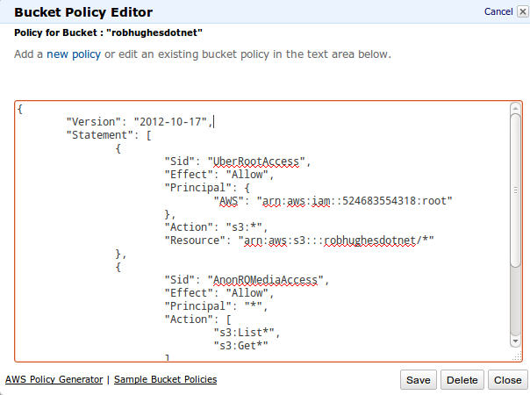
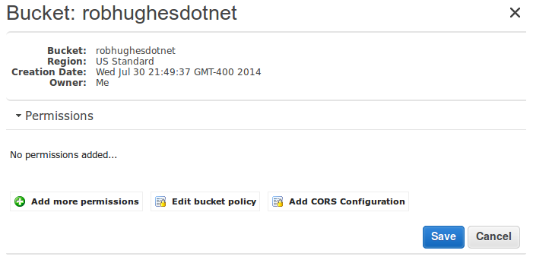
Create S3 Bucket Policy

Slide 64

S3 Bucket Policy Allows Anonymous Access To example/media/*

Slide 65
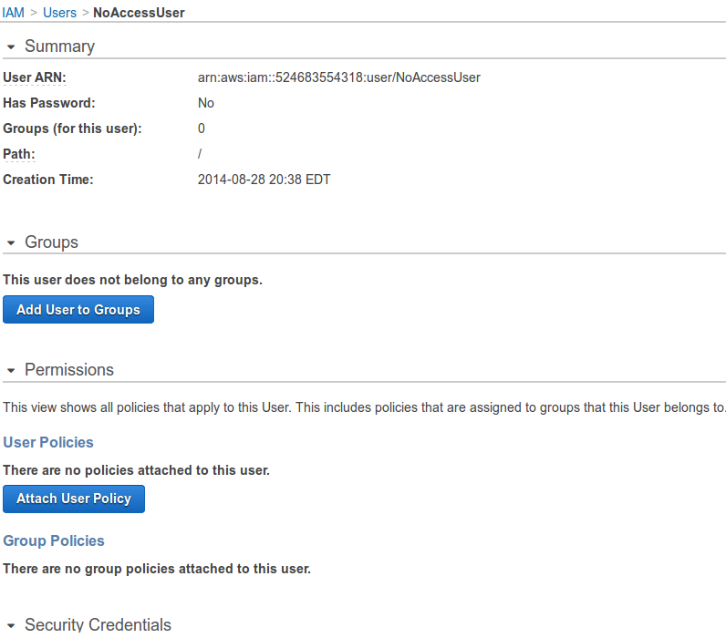
IAM User “NoAccessUser” With No Permissions

Slide 66
Grant Access To Our S3 Bucket
User Policy
The bucket policy grants total access to the robhughesdotnet bucket to the root account.
But individual IAM users still need permission
Could attach a user policy such as the one on the right:
{
"Version":"2012-10-17",
"Statement":
[
{
"Sid":“S3BucketAccess",
"Effect":"Allow",
"Action": "s3:*",
"Resource": "arn:aws:s3:::robhughesdotnet/*"
}
]
}

Slide 67
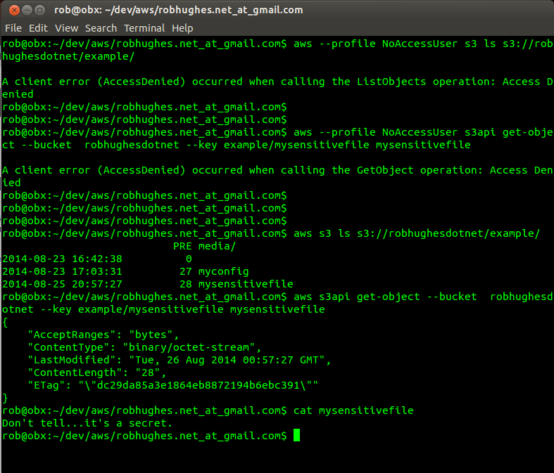
S3 Bucket Policy And Effect On IAM Users

Slide 68
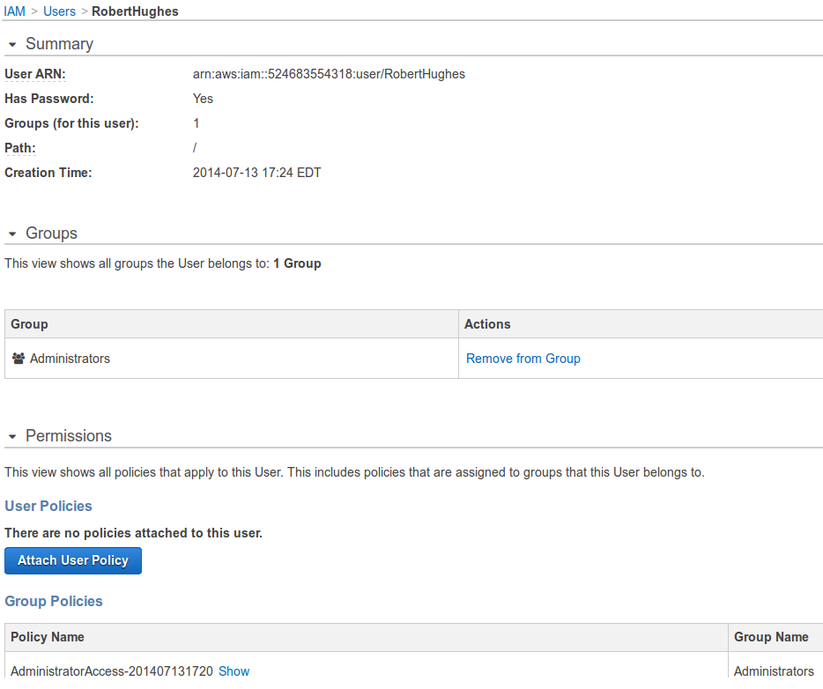
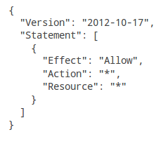
Very Permissive Admin Policy Applied To IAM Users
Admin policy granting all actions on all resources.

Slide 69
RHDN Requirements
With IAM we can now:
Create Identities used to operate website.
Create secure access keys to allow access to AWS services via various APIs.
Create users and assign passwords to allow team members to log into AWS Management console.
Create access groups to assign rules to team members granting permissions.
Create S3 bucket policies to govern access to S3 bucket content.

Slide 70
Agenda: AWS Advanced Topics
AWS Services in Detail.
Intro.
EC2.
Auto Scale.
S3.
IAM.
CloudWatch.

Slide 71
CloudWatch
Amazon CloudWatch performs real-time monitoring of AWS resources and applications.
You configure CloudWatch to collect metrics to measure variables associated with resources and applications.
You then specify rules regarding when alarms should be generated based on collected measurements and what to do when alarms change state. E.g.
Send a notification.
Make a change to allocated resources.

Slide 72
CloudWatch
CloudWatch provides visibility into resource utilization, operation usage patterns, and demand patterns.
Custom application specific metrics.
AWS monitors many built-in metrics but you can publish your own metrics

Slide 73
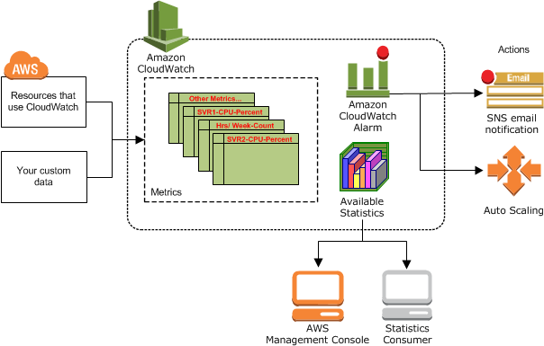
CloudWatch Architecture
Amazon CloudWatch is basically a metrics repository. An AWS product—such as Amazon EC2—puts metrics into the repository, and you retrieve statistics based on those metrics. If you put your own custom metrics into the repository, you can retrieve those statistics as well.
From: http://docs.aws.amazon.com/AmazonCloudWatch/latest/DeveloperGuide/WhatIsCloudWatch.html

Slide 74
CloudWatch Concepts Metrics
A metric is the fundamental concept in CloudWatch and represents a time-ordered set of data points. These data points can be either your custom metrics or metrics from other services in AWS. You or AWS products publish metric data points into CloudWatch and you retrieve statistics about those data points as an ordered set of time-series data.
Many built-in metrics provided by AWS.
CloudWatch stores your metric data for two weeks. You can request statistics on metric data points that occur within a specified time window.
Notes:
Think of a metric as a variable to monitor, and the data points represent the values of that variable over time. For example, the CPU usage of a particular Amazon EC2 instance is one metric, and the latency of an Elastic Load Balancing load balancer is another.
The data points themselves can come from any application or business activity from which you collect data, not just Amazon Web Services products and applications. For example, a metric might be the CPU usage of a particular Amazon EC2 instance or the temperature in a refrigeration facility.
Metrics are uniquely defined by a name, a namespace, and one or more dimensions. Each data point has a time stamp, and (optionally) a unit of measure. When you request statistics, the returned data stream is identified by namespace, metric name, dimension, and (optionally) the unit.
You can use the PutMetricData API action (or the put-metric-data command) to create a custom metric and publish data points for it. You can add the data points in any order, and at any rate you choose. CloudWatch aggregates data points that are fully identical (duplicate values, time stamps, and units) when you request statistics on them.

Slide 75
CloudWatch Concepts Namespaces
CloudWatch namespaces are containers for metrics. Metrics in different namespaces are isolated from each other, so that metrics from different applications are not mistakenly aggregated into the same statistics.
AWS provides pre-defined namespaces which largely coincide with most AWS services.
Notes:
Namespace names are strings you define when you create a metric. The names must be valid XML characters, typically containing the alphanumeric characters "0-9A-Za-z"plus "."(period), "-" (hyphen), "_" (underscore), "/" (slash), "#" (hash), and ":" (colon). AWS namespaces all follow the convention AWS/<service>, such as AWS/EC2 andAWS/ELB.
Note
Namespace names must be fewer than 256 characters in length.
There is no default namespace. You must specify a namespace for each data element you put into CloudWatch.

Slide 76
Pre-defined AWS Namespaces
All AWS services that provide Amazon CloudWatch data use a namespace string, beginning with "AWS/". The following services push metric data points to CloudWatch.
AWS Product | Namespace
Auto Scaling | AWS/AutoScaling
AWS Billing | AWS/Billing
Amazon DynamoDB | AWS/DynamoDB
Amazon ElastiCache | AWS/ElastiCache
Amazon Elastic Block Store | AWS/EBS
Amazon Elastic Compute Cloud | AWS/EC2
Elastic Load Balancing | AWS/ELB
Amazon Elastic MapReduce | AWS/ElasticMapReduce
Amazon Kinesis | AWS/Kinesis
AWS OpsWorks | AWS/OpsWorks
Amazon Redshift | AWS/Redshift
Amazon Relational Database Service | AWS/RDS
Amazon Route 53 | AWS/Route53
Amazon Simple Notification Service | AWS/SNS
Amazon Simple Queue Service | AWS/SQS
Amazon Simple Workflow Service | AWS/SWF
AWS Storage Gateway | AWS/StorageGateway
From:
http://docs.aws.amazon.com/AmazonCloudWatch/latest/DeveloperGuide/aws-namespaces.html

Slide 77
CloudWatch Concepts Dimensions
A dimension is a name/value pair that helps you to uniquely identify a metric.
Think of dimensions as categories of variables within a metric.
CloudWatch treats each unique combination of dimensions as a separate metric.

Slide 78
Dimensions Example
Metric
None
InstanceId
AutoScalingGroup
CPUUtilization
Namespace:AWS/EC2
Statistic:Average
Dimension
Example
N/A
i-8374736c
RHDNStack-WebServerGroup-38326FEEQX5P
Result
All CPUUtilization data points across all EC2 instances.
All CPUUtilization data points for EC2 instance with InstanceId=i-8374736cc
All CPUUtilization data points aggregated for EC2 instances for RHDN…QX5P- auto scaling group

Slide 79
aws CLI Example
Sample aws CLI use with cloudwatch subcommand:
aws cloudwatch get-metric-statistics --metric-name CPUUtilization --start-time 2014-08-28T00:18:00 --end-time 2014-08-30T23:59:59 --period 300 --namespace AWS/EC2 --statistics Average --dimensions Name=AutoScalingGroupName,Value=RHDNStack-WebServerGroup-38326FEEQX5P
aws cloudwatch get-metric-statistics --metric-name CPUUtilization --start-time 2014-08-28T00:18:00 --end-time 2014-08-30T23:59:59 --period 300 --namespace AWS/EC2 --statistics Average --dimensions Name=InstanceId,Value=i-8374736c
Sample output:
{
"Datapoints": [
{
"Timestamp": "2014-08-29T23:48:00Z",
"Average": 10.962,
"Unit": "Percent"
},
{
"Timestamp": "2014-08-30T01:48:00Z",
"Average": 4.646000000000001,
"Unit": "Percent"
},
<snip>
],
"Label": "CPUUtilization"
}

Slide 80
CloudWatch Concepts
Time Stamps.
With Amazon CloudWatch, each metric data point must be marked with a time stamp. The time stamp can be up to two weeks in the past and up to two hours into the future.
Units.
Units represent your statistic's unit of measure.
Units help provide conceptual meaning to your data.

Slide 81
CloudWatch Concepts Statistics
Statistics are metric data aggregations over specified periods of time.
Statistic | Description
Minimum | The lowest value observed during the specified period. You can use this value to determine low volumes of activity for your application.
Maximum | The highest value observed during the specified period. You can use this value to determine high volumes of activity for your application.
Sum | All values submitted for the matching metric added together. This statistic can be useful for determining the total volume of a metric.
Average | The value of Sum / SampleCount during the specified period. By comparing this statistic with the Minimum and Maximum, you can determine the full scope of a metric and how close the average use is to the Minimum and Maximum. This comparison helps you to know when to increase or decrease your resources as needed.
SampleCount | The count (number) of data points used for the statistical calculation.
From:
http://docs.aws.amazon.com/AmazonCloudWatch/latest/DeveloperGuide/cloudwatch_concepts.html

Slide 82
CloudWatch Concepts Periods
A period is the length of time associated with a specific Amazon CloudWatch statistic. Each statistic represents an aggregation of the metrics data collected for a specified period of time.
Notes:
From: http://docs.aws.amazon.com/AmazonCloudWatch/latest/DeveloperGuide/cloudwatch_concepts.html
When you call GetMetricStatistics, you can specify the period length with the Period parameter. Two related parameters, StartTime and EndTime, determine the overall length of time associated with the statistics. The default value for the Period parameter is 60 seconds, whereas the default values for StartTime and EndTime give you the last hour's worth of statistics.
The values you select for the StartTime and EndTime parameters determine how many periods GetMetricStatistics will return. For example, calling GetMetricStatistics with the default values for the Period, EndTime, and StartTime parameters returns an aggregated set of statistics for each minute of the previous hour. If you prefer statistics aggregated into ten-minute blocks, set Period to 600. For statistics aggregated over the entire hour, use a Period value of 3600.
Periods are also an important part of the CloudWatch alarms feature. When you create an alarm to monitor a specific metric, you are asking CloudWatch to compare that metric to the threshold value that you supplied. You have extensive control over how CloudWatch makes that comparison. Not only can you specify the period over which the comparison is made, but you can also specify how many consecutive periods the threshold must be breached before you are notified. For more information about alarms, seeAlarms.

Slide 83
CloudWatch Concepts Aggregation.
Amazon CloudWatch aggregates statistics according to the period length.
Aggregated statistics are only available when using detailed monitoring.
Amazon CloudWatch does not aggregate data across Regions.
Notes:
From: http://docs.aws.amazon.com/AmazonCloudWatch/latest/DeveloperGuide/cloudwatch_concepts.html
You can publish data points for a metric that share not only the same time stamp, but also the same namespace and dimensions. Subsequent calls to GetMetricStatisticsreturns aggregated statistics about those data points. You can even do this in one PutMetricData request. CloudWatch accepts multiple data points in the samePutMetricData call with the same time stamp. You can also publish multiple data points for the same or different metrics, with any time stamp. The size of a PutMetricDatarequest, however, is limited to 8KB for HTTP GET requests and 40KB for HTTP POST requests. You can include a maximum of 20 data points in one PutMetricData request.
For large data sets that would make the use of PutMetricData impractical, CloudWatch allows for the insertion of a pre-aggregated data set called a StatisticSet. With StatisticSets you give CloudWatch the Min, Max, Sum, and SampleCount of a number of data points. StatisticSets is commonly used when you need to collect data many times in a minute. For example, let’s say you have a metric for the request latency of a web page. It doesn’t make sense to do a PutMetricData request with every web page hit. We suggest you collect the latency of all hits to that web page, aggregate them together once a minute and send that StatisticSet to CloudWatch.
Amazon CloudWatch doesn't differentiate the source of a metric. If you publish a metric with the same namespace and dimensions from different sources, CloudWatch treats this as a single metric. This can be useful for service metrics in a distributed, scaled system. For example, all the hosts in a web server application could publish identical metrics representing the latency of requests they are processing. CloudWatch treats these as a single metric, allowing you to get the statistics for minimum, maximum, average, and sum of all requests across your application.

Slide 84
CloudWatch Concepts Alarms
Automatically initiate actions on your behalf, based on parameters you specify.
An alarm watches a single metric over a specified time period, and performs one or more actions based on the value of the metric relative to a given threshold over a number of time periods.
CloudWatch alarms will not invoke actions simply because they are in a particular state, the state must have changed and been maintained for a specified number of periods.

Slide 85
CloudWatch Concepts Alarms
Alarms can be in three states:
OK.
The metric is within the defined threshold.
ALARM.
The metric is outside the defined threshold.
INSUFFICIENT_DATA.
The alarm has just started, the metric is not available, or not enough data is available for the metric to determine the alarm state.

Slide 86
CloudWatch and EC2
EC2 is a prominent resource monitored by CloudWatch.
For Amazon EC2 instances CloudWatch basic monitoring collects and reports usage metrics for CPU utilization, data transfer, and disk usage for each EC2 instance at a five-minute frequency.
Amazon detailed monitoring provides the same metrics at one-minute intervals and enables data aggregation by AMI ID and instance type.
The same metrics are available for servers in an autoscale group using the AutoScaleGroup dimension.

Slide 87
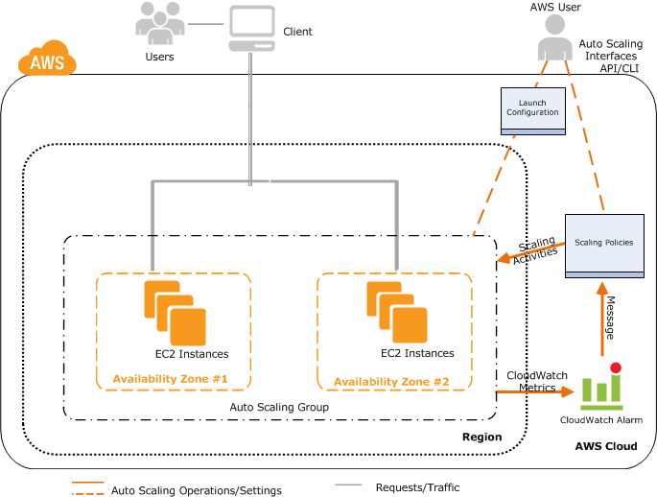
CloudWatch and EC2 Architecture
From: http://docs.aws.amazon.com/AutoScaling/latest/DeveloperGuide/as-scale-based-on-demand.html

Slide 88
CloudWatch Use:
CloudWatch is accessible via AWS Management console, APIs, CLI, and SDKs.

Slide 89
CloudWatch Alarms/Policies To Support Autoscaling
Internet connection?
Yes
Create CloudWatch alarms and auto scaling policies
No
Static screen snaps

Slide 90
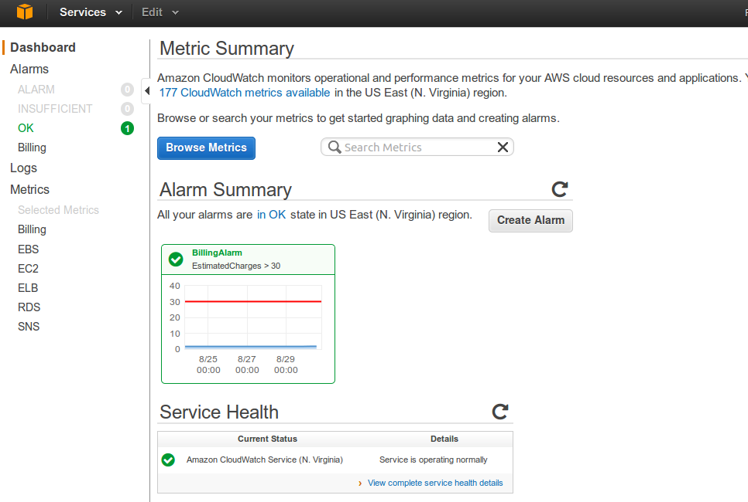
CloudWatch Dashboard

Slide 91
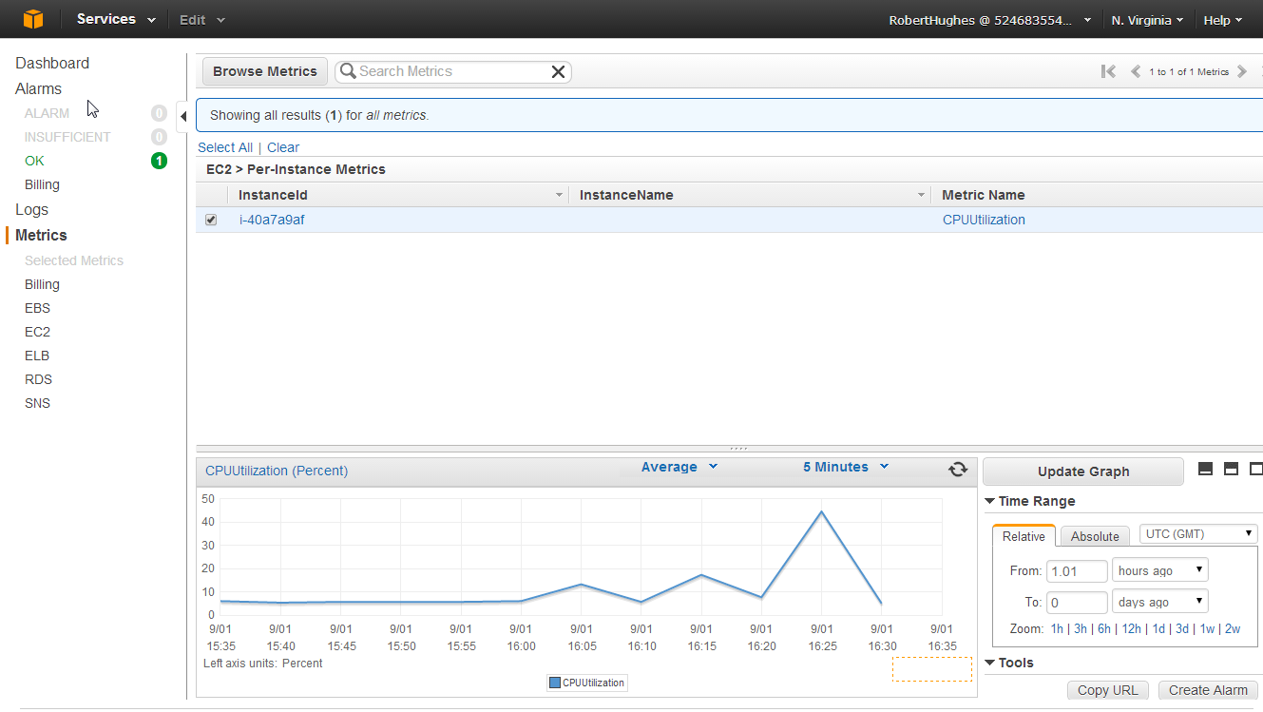
CloudWatch Monitoring EC2 Instance – CPUUtilization Metric

Slide 92
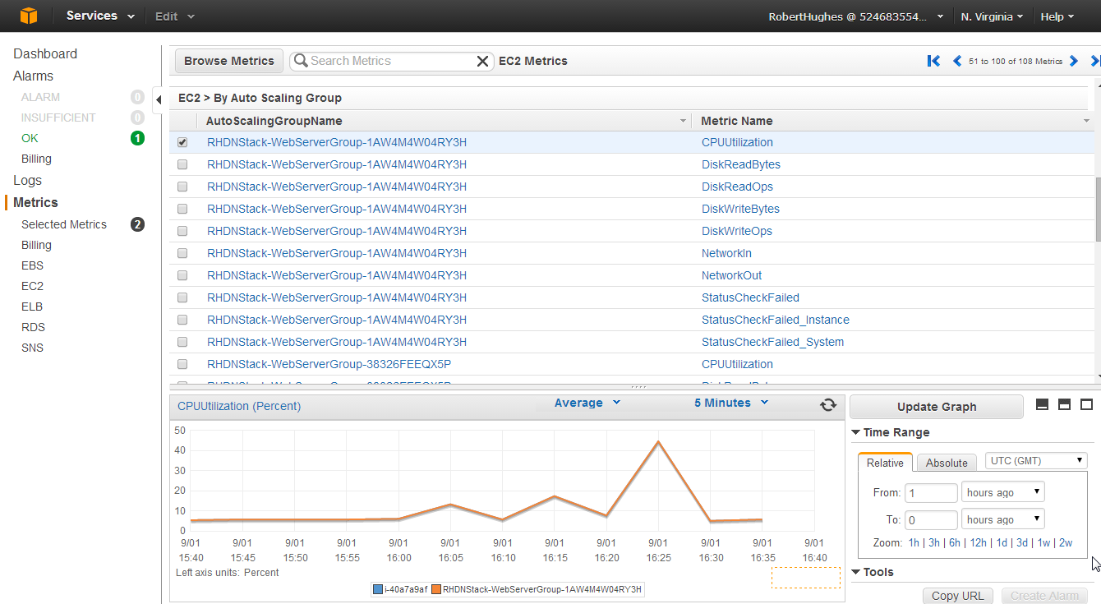
CloudWatch Monitoring Autoscaling Group – CPUUtilization

Slide 93
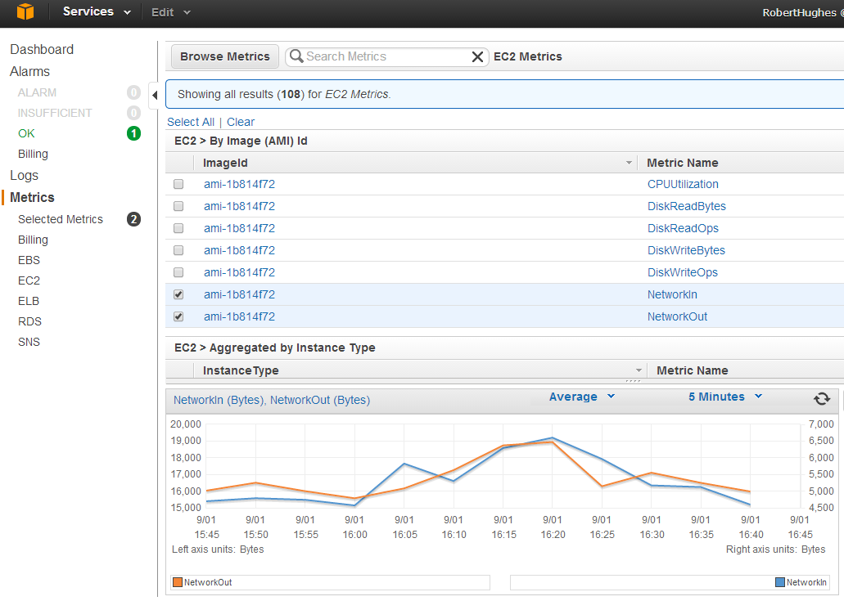
CloudWatch Monitoring By Image Id – Network In/Out

Slide 94
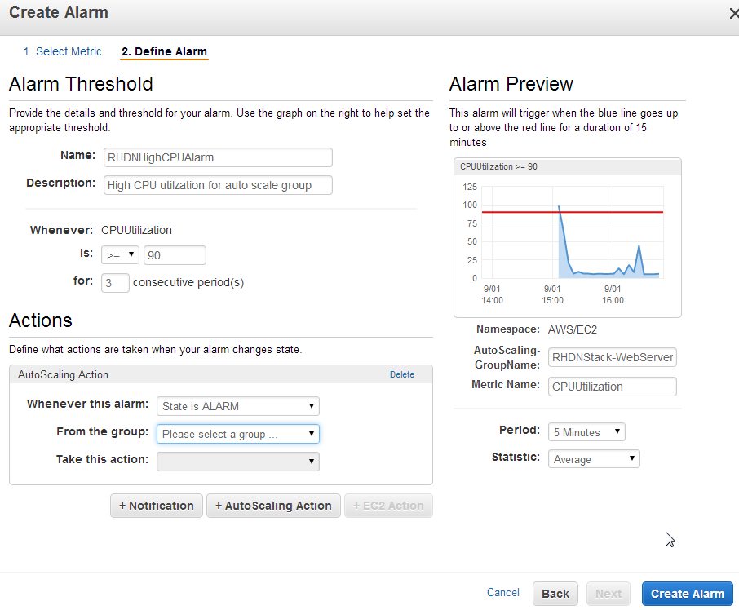
CloudWatch Create Alarm*Fails* Select dropdown doesn’t populate

Slide 95
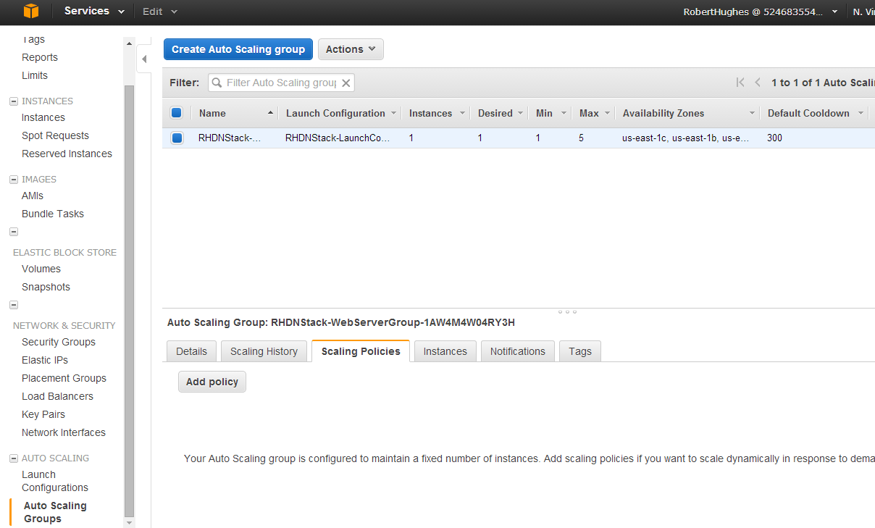
CloudWatch Create Scaling Policies And Alarms

Slide 96
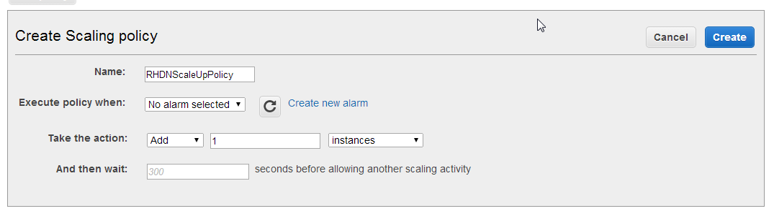
CloudWatch Scale Up Policy

Slide 97
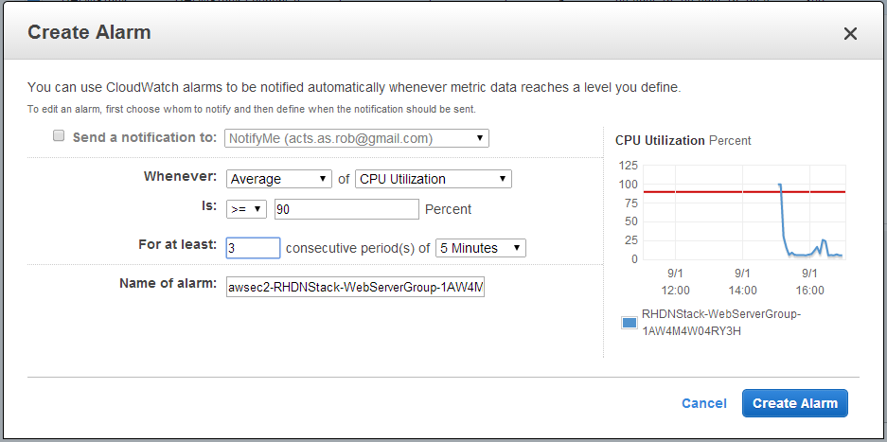
CloudWatch Autoscale Group High CPU Alarm

Slide 98
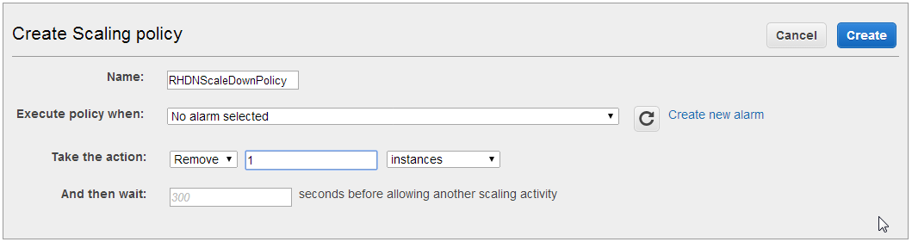
CloudWatch Scale Down Policy

Slide 99
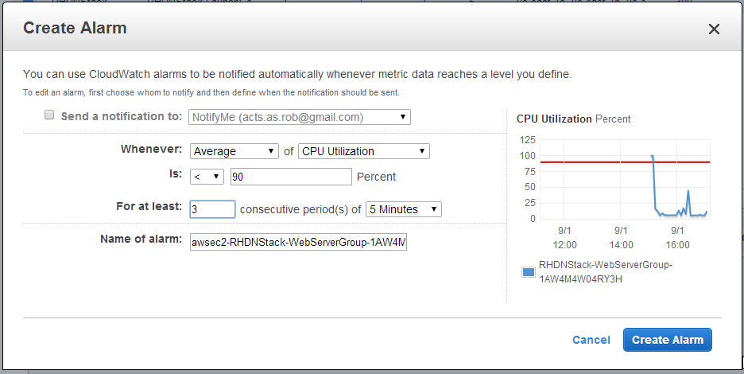
CloudWatch Autoscale Group Low CPU Alarm

Slide 100
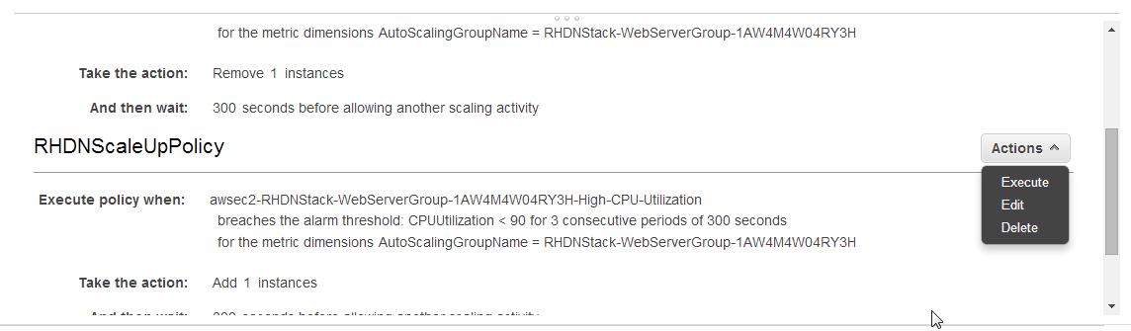
CloudWatch Test By Forcing Execution Of Scale Up Policy

Slide 101
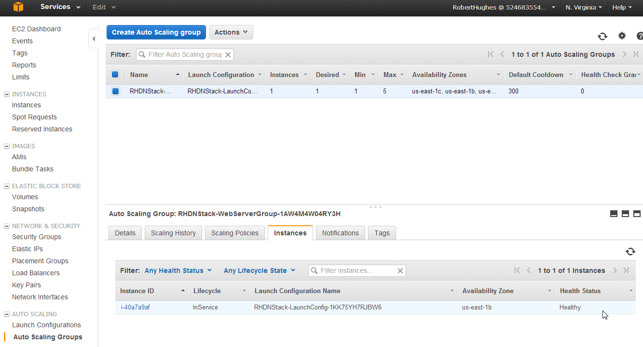
EC2 Autoscale Group Summary Note: Instance Count = 1

Slide 102
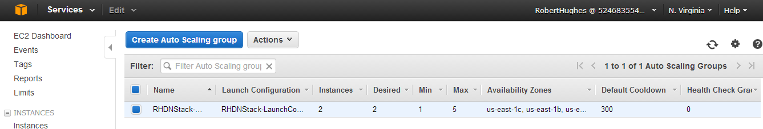
EC2 Autoscale Group Summary Change In Capacity
NOTE: Instance count = 2

Slide 103
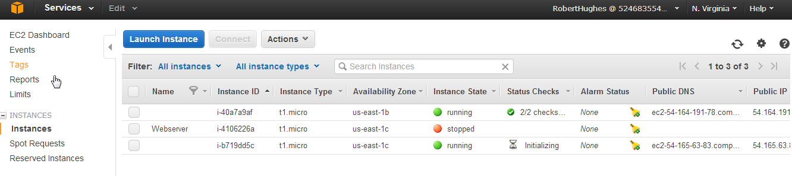
EC2 Summary New Instance Initializing

Slide 104
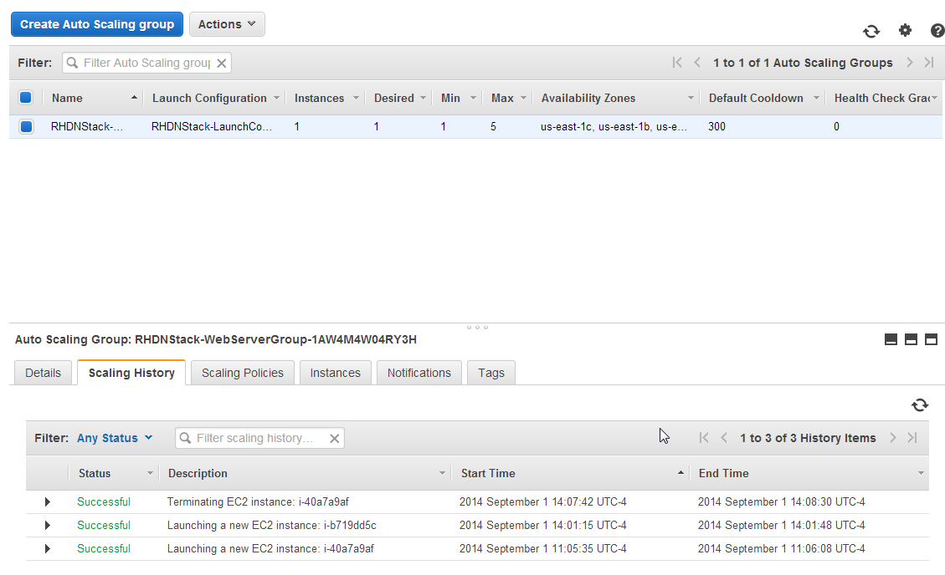
EC2 Autoscale Group History

Slide 105
RHDN Requirements
With CloudWatch we can now:
Create alarms to signal various events.
Create auto scaling policies to take action when alarm events occur.
Attach auto scale policies to auto scale groups to automate auto scale activities for website.

Slide 106
RHDN Requirements
Software.
Apache httpd/Phusion Passenger in front of Ruby 2.x/Rails 4.1.
MySQL RDBMS.
Linux OS. Red Hat variant preferred.
Security.
Restrict access to HTTP/ssh (80, 22) for web-tier.
Restrict access to MySQL port and ssh (3306, 22) for data-tier.
Restrict who can log into web/data-tier.

Slide 107
RHDN Requirements
AWS.
Autoscaled server instances. Cluster grows/shrinks to meet demands.
Highly available infrastructure.
Load balancer for web-tier.
DNS entry for www.robhughes.net.
Stage static content (images).
Ability to create duplicate environments for dev/test.

Slide 108
Backup Slides

Slide 109
Why Requests Are Signed*
The signing process helps secure requests in the following ways:
Verify the identity of the requester. Signing makes sure that the request has been issued by someone who has a valid access key ID and secret access key. For information about getting access keys, see How Do I Get Security Credentials? in the AWS General Reference.
Requests can also be signed using temporary security credentials that are obtained using a call to an AWS STS API like AssumeRole or GetFederationToken. In that case, the request must include security token that's part of the temporary security credentials. For more information, go to Creating Temporary Security Credentials in the AWS Security Token Service documentation.
Protect data in transit. In order to prevent tampering with a request while it is in transit, some of the request elements are used to calculate a hash (digest) of the request, and the resulting hash value is included as part of the request. When AWS receives the request, it calculates a hash based on the same information and matches it against the hash value in the request that you include. If the hash values don't match, AWS denies the request.
Protect against potential replay attacks. A request must reach AWS within 15 minutes of the time stamp in the request. Otherwise, AWS denies the request.
*http://docs.aws.amazon.com/general/latest/gr/signing_aws_api_requests.html

Slide 110
Roles (Delegation and Federation)
AWS lists the following uses of IAM Roles:
Applications running on Amazon EC2 instances that need to access AWS resources
If an application runs on an Amazon EC2 instance and needs to make requests for AWS resources such as Amazon S3 buckets or an DynamoDB table, it must have security credentials. It isn't a good practice to embed or pass IAM user credentials to each instance—distributing long-term credentials to each instance is challenging to manage and a potential security risk. A better strategy is to create a role that is used when the Amazon EC2 instance is launched. An application can then get temporary security credentials from the Amazon EC2 instance. For more information, see Granting Applications that Run on Amazon EC2 Instances Access to AWS Resources.
Cross-account access
To manage access to resources, you might have multiple AWS accounts—for example, to isolate a development environment from a production environment. However, users from one account might need to access resources in the other account, such as promoting an update from the development environment to the production environment. Although users who work in both accounts could have a separate identity in each account, managing credentials for multiple accounts makes identity management difficult. Instead, you can create a role in an account that lets a user from the other account securely access resources. For more information, see Cross-Account API Access Using IAM Roles.
Identity federation
Users might already have identities outside of AWS, such as in your corporate directory. However, those users might need to work with AWS resources (or work with applications that access those resources). If so, users also need AWS security credentials in order to make programmatic requests to AWS. To provide these credentials, you can use IAM roles, which let you specify permissions for users whose identity is federated from your organization. For more information, see Using Your Company's Own Authentication System to Grant Access to AWS Resources and Creating Temporary Security Credentials to Enable Access for Federated Users in the Using Temporary Security Credentials guide.
If your organization supports SAML 2.0 (Security Assertion Markup Language 2.0), you can create trust between your organization as an identity provider (IdP) and other organizations as service providers. In AWS, you can configure AWS as the service provider and use SAML to provide your users with federated single-sign on (SSO) to the AWS Management Console or to get federated access to call AWS APIs. For more information, see Creating Temporary Security Credentials for SAML Federation in the Using Temporary Security Credentials guide.
Web identity federation
If you create a mobile or web-based app that accesses AWS resources, the app needs security credentials in order to make programmatic requests to AWS.

